Slide 1
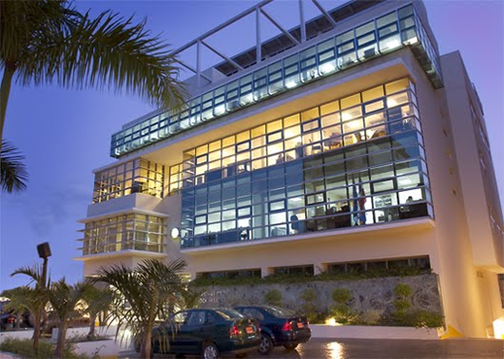
The Dominican Tax Reform of 2012 in Historical and Regional Context
James Mahon
Williams College
and Research Fellow,
Funglode, 2013-14

Slide 2
Recent regional averages of relative weights of personal income taxation and consumption taxation in total revenues, percent, two periods
N = number of countries contributing to the average by having at least one year in the period with reported data for both personal income taxes and consumption taxes
* For 1993-99, Lat Am = Bra, Gua, Pan, Par, Per, Uru, Ven; for 2000-06, Lat Am = Arg, Bol, Gua, Pan, Par, Per, Uru, Ven
** Complete data for all ten in all years: Arg, Bol, Bra, Chi, Col, DR, Gua, Mex, Per, Uru. Includes subnational consumption tax revenue for Arg, Bra
Sources: IMF, Government Finance Statistics; World Bank, World Development Indicators; Inter-American Development Bank/ Centro Interamericano de Administradores Tributarios (CIAT) database 2012.
 | 1993-99 |  |  | 2000-06
Region or Group | Personal Income Tax | Consumption Taxes | N | Personal Income Tax | Consumption Taxes | N
OECD Europe | 19.4 | 27.9 | 15 | 19.5 | 30.4 | 14
USA and other rich ex-British colonies | 39.7 | 17.6 | 2 | 38.3 | 19.8 | 5
Latin America | 2.5 | 37.3 | 7* | 2.9 | 38.1 | 8*
Latin America IDB-CIAT |  |  |  | 4.63 | 37.04 | 10**
Sub-Saharan Africa | 11.2 | 22.5 | 16 | 13.1 | 26.8 | 20
Eastern Europe and Eurasian ex-Communist | 6.9 | 40.0 | 13 | 7.6 | 41.2 | 21
South and East Asia | 10.8 | 25.5 | 13 | 9.5 | 29.6 | 15
Middle East and North Africa | 3.3 | 11.1 | 10 | 8.2 | 20.7 | 8

Slide 4
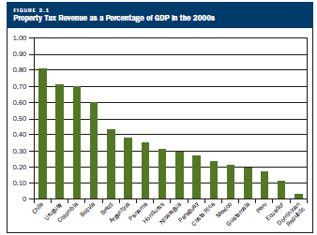
Source: Claudia De Cesare (2012) “Improving the Performance of the Property Tax in Latin America,” Lincoln Institute for Land Policy, Policy Focus Report, p. 9.

Slide 6
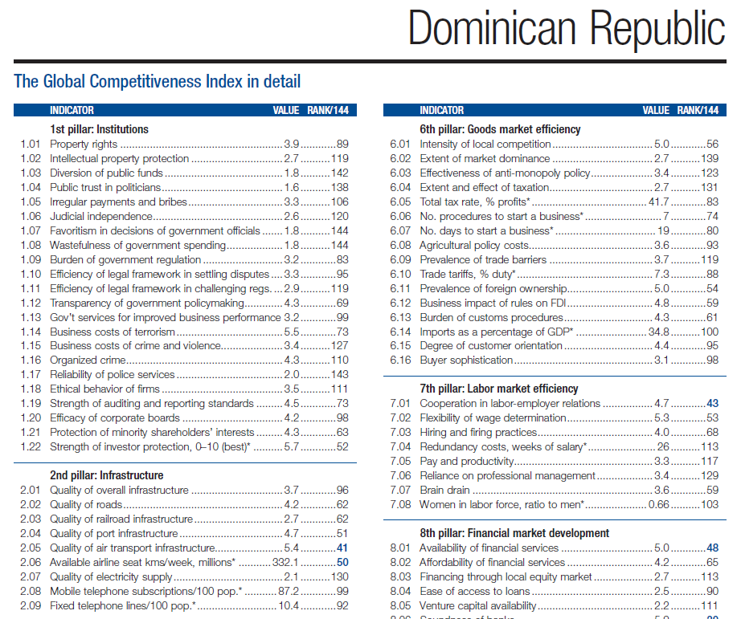
World Economic Forum, 2012
The DR finishes last in “wastefulness of government spending”

Slide 8
Major features of Law 258-12
General VAT (ITBIS) rate to rise from 16 to 18 percent for two years (2013-2014), falling back to 16 percent in 2015
Popular consumer goods lose exemption from ITBIS: most food now at special rate of 8 percent, which rises by steps to the general rate of 16 percent in 2016
Corporate income tax: a few exemptions ended or reduced alongside general rate cut from 29 to 27 percent starting in 2014
Personal income tax: initiation of dual structure, with 10 percent of capital income withheld at source
Real estate taxes (IPI): taxable value calculated from total belonging to owner, rather than by property; increase of the basic exemption (to RD$ 6,500,000)

Slide 9
Why was a tax reform done immediately?
Publicity about burst of public investment spending in election season
Additional spending promises by candidate Medina-- e.g., education
Desire to begin term with good report from IMF
Easy to pass in Congress because of PLD dominance
However, hard to get a favorable consensus in the Economic and Social Council (CES) because of bad reputation of public spending
CES negotiations repeatedly postponed, then abruptly cut short
Better question: Why was the reform relatively timid, despite extraordinarily favorable political conditions?

Slide 10
Year and law | Major changes and taxes | Tariffs and other details | President and ruling party | Senate | House of Representatives | External commitments | Comments
1983 74 | Creation of the ITBI, 6 percent | Tariffs are still high | Blanco PRD | PRD 17 PLD 0 RP 10 | PRD 62 PLD 7 RP 50 | IMF Extended Funds Facility | Acute B of P and fiscal crisis; proposed a 50% limit to exemptions
1992 11-92 | ITBIS, up from 6 to 8%; differential on oil; simplification; elimination of incentives in three years | Drop in tariffs by decree 1991; agreement to rationalize 1993 had no real effect | Balaguer PRSC | PRD 2 PLD 12 PRSC 16 | PRD 33 PLD 44 PRSC 41 | IMF Stand-by | Acute crisis in B of P, fisc, inflation, and politics; Solidarity Pact in August 1990
2000 112-00 147-00 | Excises on hydrocarbons, others; ITBIS from 8 to 12%; CIT (Income tax) advance payment 1.5% of gross income | Tariff reductions in Law 146-00 | Mejía PRD | PRD 24 PLDD 4 PRSC 2 | PRD 83 PLD 49 PRSC 17 |  | "Social debt"; first step toward decreasing the importance of tariffs
2004 288-04 | ITBIS from 12 to 16% | Emergency 1-04 and 2-04; bank bailout | Fernández PLD in pact with Mejía | PRD 29 PLD 2 PRSC 1 | PRD 73 PLD 41 PRSC 36 | IMF Stand-by | Fiscal deficit because of banking crisis
2005 557-05 | Hike in excises, capital income withholding | Compensates losses for DR- CAFTA | Fernández PLD |  |  |  | Needed because of DR-CAFTA
2012 258-12 | ITBIS from 16 to 18% until 2015, now includes additional products; dual PIT w/ withholding of K income | Anticipates other DR-CAFTA losses | Medina PLD | PRD 0 PLD 31 PRSC 1 | PRD 75 PLD 105 PRSC 3 |  | Fiscal deficit, electoral expenditure, future expenditure commitments

Slide 12
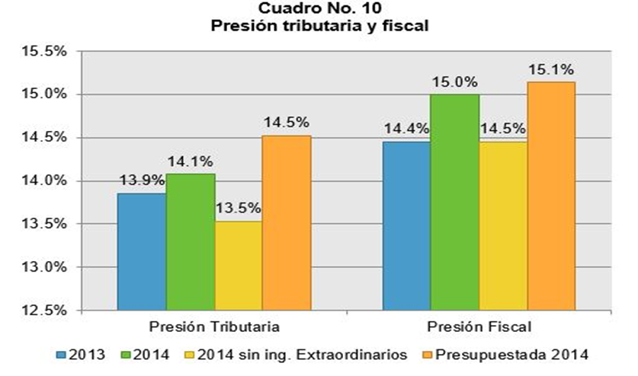
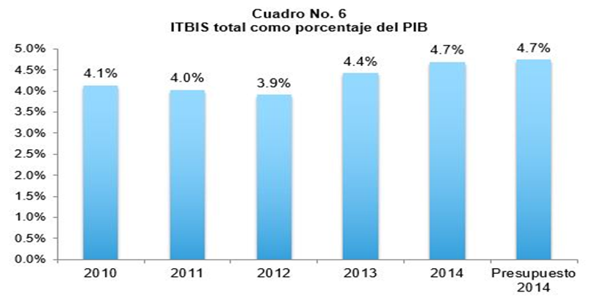
Results: Disappointing
Despite good economic growth, tax revenue as a proportion of GDP has not risen
Figures from Germania Montas, Consultores para el Desarrollo, blog, 5 Jan. 2015

Slide 13
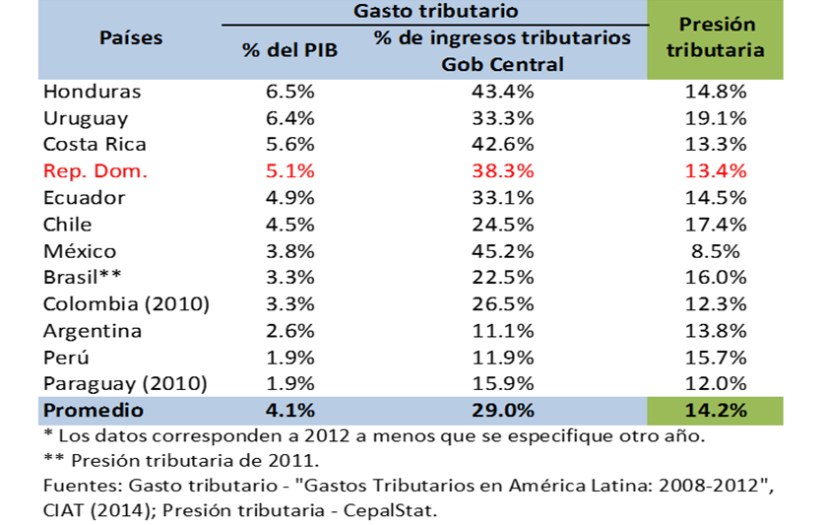
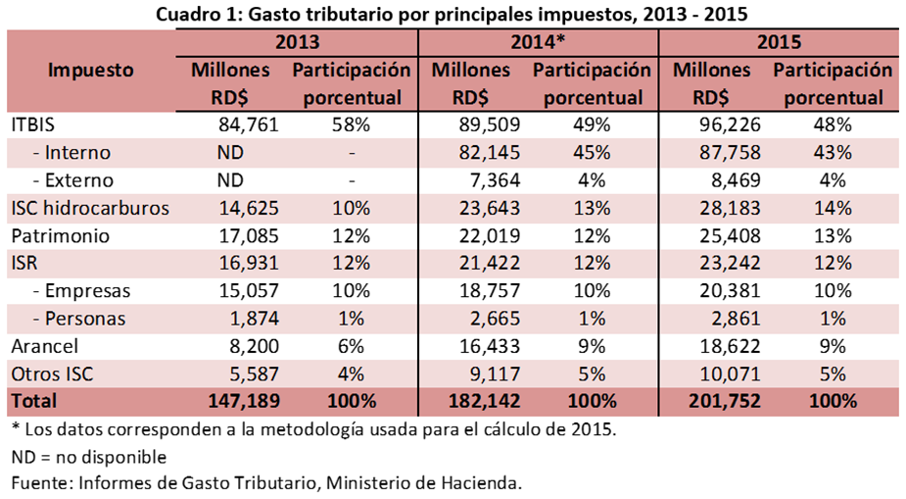
Why not?
The proliferation of tax exemptions has robbed the tax system of “buoyancy”: the income elasticity of tax revenue may have fallen to approach unity
Tables from Germania Montas, Consultores para el Desarrollo, blog, 6 April 2015

Slide 14
Roadmap for additional reforms can be found in the National Development Strategy (END) of 2012
Improve the transparency and effectiveness of government spending (general objective 1.1 and goal 3.1.2.2)
Make the tax system progressive, emphasizing direct taxation and in accord with ability to pay, while eliminating distortionary tax exemptions (goal 3.1.2.1)
Raise the tax revenue level to 16 percent of GDP by 2015, 19 percent by 2020, and 24 percent by 2030 (goal 3.25)
And one is a no-brainer:
Merge the tax administration (DGII) with customs (DGA)

Slide 15
Issues for the near future
Chronic deficit squeezes public investment and social spending; expect it to rise in election year 2016
Moderate vulnerability to rises in interest rates, but likely to increase
Growing failure to meet revenue (and spending) targets of the END
However, in the absence of a fiscal crisis and a political opposition (beyond ruling PLD), the existing fiscal structure will be undisturbed
Fiscal Pact in the CES will not be finished this presidential term

Slide 16
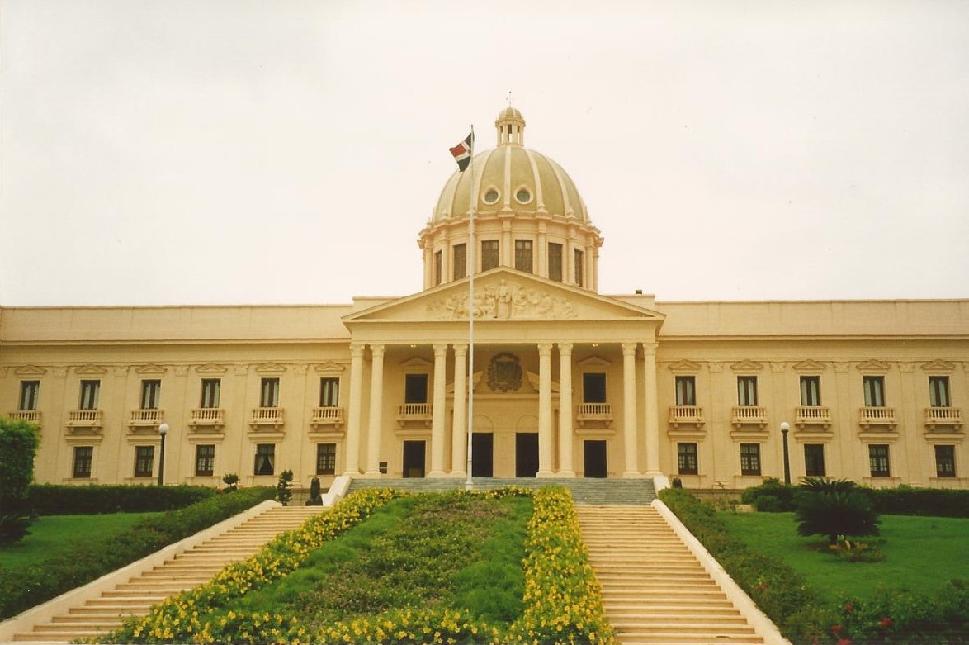
Thanks for your attention.

