Slide 1
Best Practices in the Tax Administration for Sustained Revenue Increase for Social Development

Slide 2
Context (1/2)
The State’s capacity of spend or invest depends basically on resources generated by the Tax System.
In each decision of spend there is an implicit decision of recover.
The social investment is related directly to tax burden, because that depends the capacity of spend.

Slide 3
Context (2/2)
The long term investment for sustainable development is guaranteed with:
Tax rules: for management of public finances, that guarantee rational use of resources and creation of “anti cyclical” funds to maintain the social expenditure.
State’s capacity of generating sufficient resources – Tax System
Strong Tax Administration in order to implement the tax system

Slide 4
Principles of Tax System
Tax System must comply with the principles of:
Suficiency: is those that generates the resources required by the State as established in its design
General: when establishes tax burdens for all as common duty of citizens;
Simple: if the process of compliance and control is clear;
Equitable, when everyone pays according to their capacity to pay (horizontal equity) and treated equal to the same and unequal to those that are not in same circumstances (vertical equity).

Slide 5
Tax Rules
Are formal or informal rules, quantitative and qualitative, to ensure that tax police management is prudent; to achieve “tax responsiblity”.
Propose limits for indebteness, for relation between current expenses and investment, transparency in budget management, etc.

Slide 6
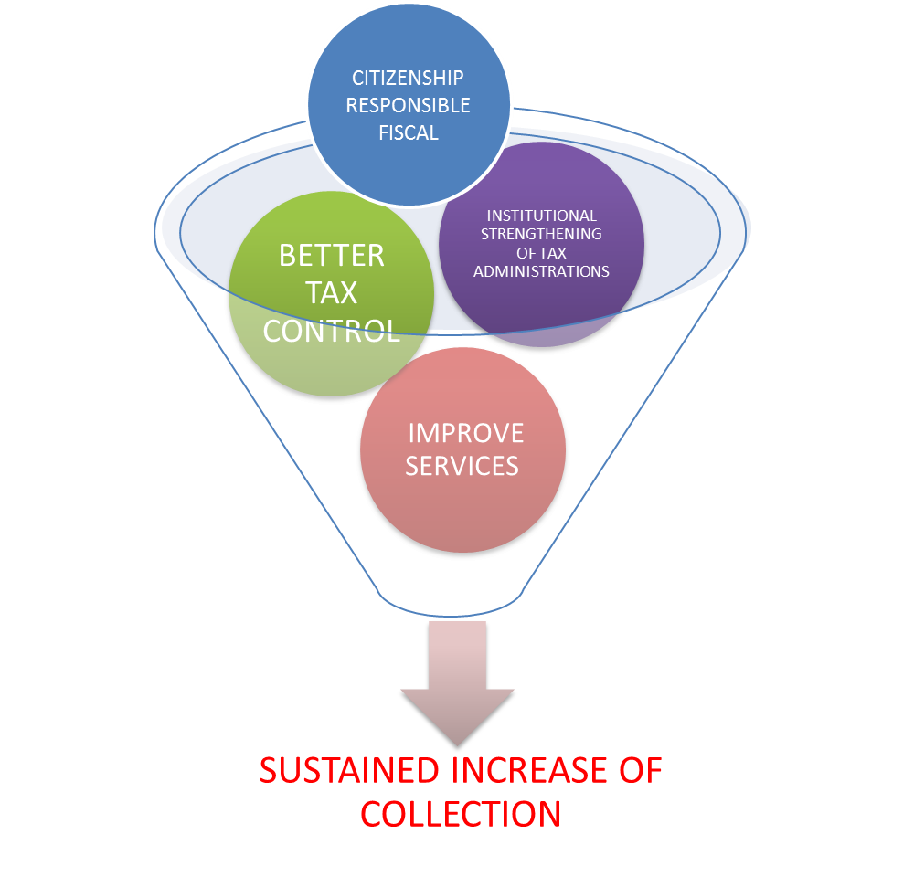
“a Tax System is worth what is worth the Tax Administration that manages it”

Slide 7
Tax Control
Efficient tax control deters the noncompliance and promotes voluntary compliance.
Tendencies:
Invoicing control
Intensive use of Information Technologies (IT)
Control of International Taxation

Slide 8
Improved Services
Balance between control and facilitation

Slide 9
Improved Services
Facilitated compliance should be part of the tax administrations and should operate as part of the State.
Facility induces compliance

Slide 10
Responsible Tax-paying Citizenship
“A sustainable taxation system is that in which taxpayers consider that taxes payment is a civic responsibility that allow them enjoy all rights that a canadian resident or entity has.”
Source: Presented by representative of Canada Revenue Agency – CRA-
in 45th General Assembly of CIAT, “Tax Morale as a Determining Factor in the Improvement of
Effectiveness of Tax Administration.” 2011 in Ecuador.

Slide 11
Responsible Tax-paying Citizenship
In an inquiry performed by Ernst and Young in the USA, for the question “How much influence has each of the following factors in the fact that you declare and pay your taxes with honesty?” These answers about factors were as follows:
Fear of an audit: 64%
Belief that their neighbors declare and pay honestly: 44 %
Third parties who report your incomes to Internal Taxes Services: 66 %
Its personal integrity: 92%
Source: Presented by Deborah Nolan in Fuente: Presentado por Deborah Nolan in 45th General Assembly of CIAT, “Tax Morale as a Determining Factor in the Improvement of
Effectiveness of Tax Administration.” 2011 in Ecuador.

Slide 12
Responsible Tax Citizenship
Countries that enjoy higher levels of voluntary compliance are those in which citizens show a citizenship with greater tax responsibility.
It is like if there were a permanent tax deal in order to build a beter nation.

Slide 13
Institutional Strengthening
Provide Tax Administration (TA) with public servers who are ethically and professionally unobjectionable must be a long term commitment of the countries.
TA must have special laws for managment of human resources.

Slide 14
Institutional Strengthening

Slide 15
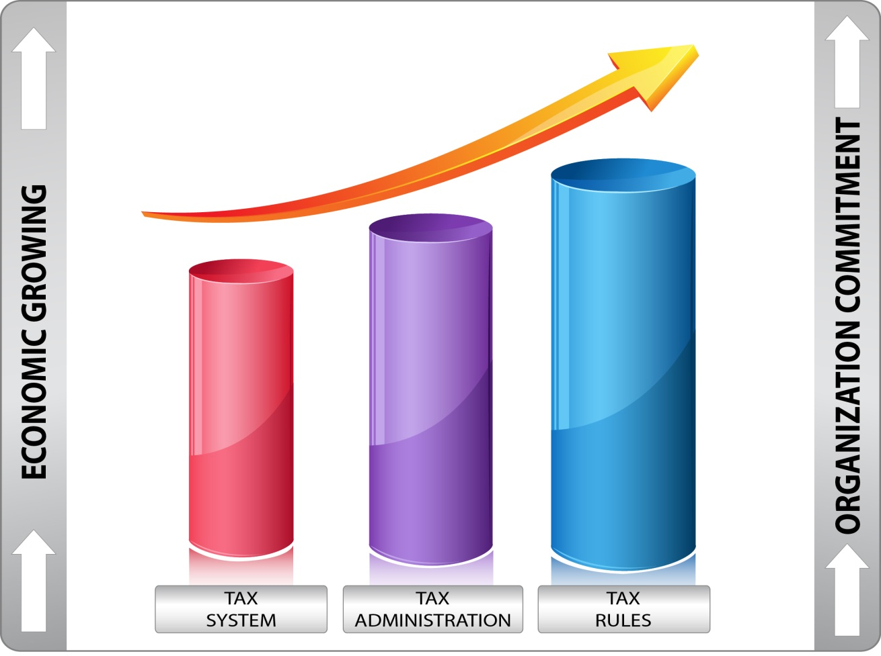
Summary

Slide 16
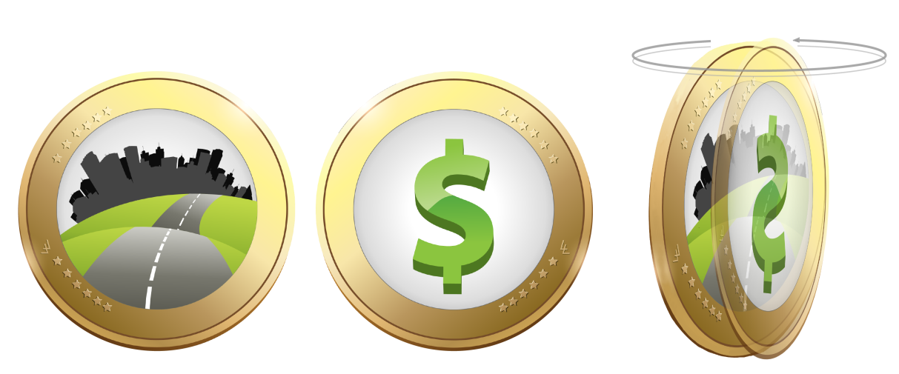
INCOME AND EXPENSES ON BOTH SIDES OF THE SAME COIN
Conclusion

Slide 17
Thanks for your attention montasyapurg@gmail.com gmontas@consultoresparaeldesarrollo.com

